Slide 1


Data Structures
Lab # 7 Stack

Slide 2

Stack
A stack is a linear data structure that operates on a LIFO (Last-In, First-Out) principle.
All operations, like adding or removing elements, only happen at one end of the structure, known as the top.`

Slide 3
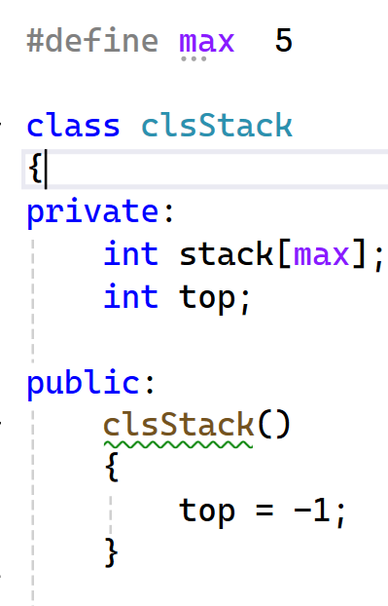
Stack
This is the actual data storage for the stack.
It will always store the index of the last element that was added (the "top" of the stack).
Constructor that initialize the members.

Slide 4
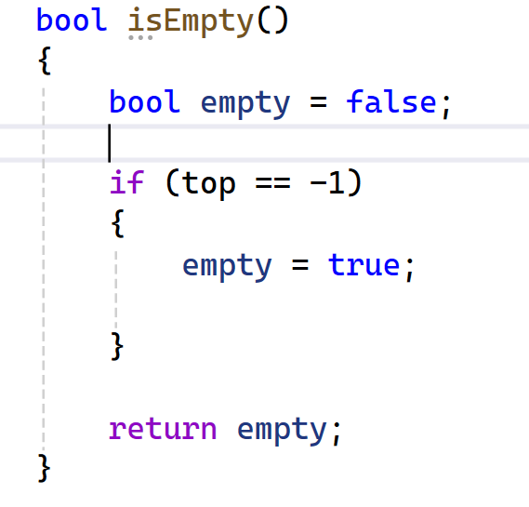
Stack
This is the check. If top is still -1 (its initial value), it means nothing has been pushed onto the stack.

Slide 5
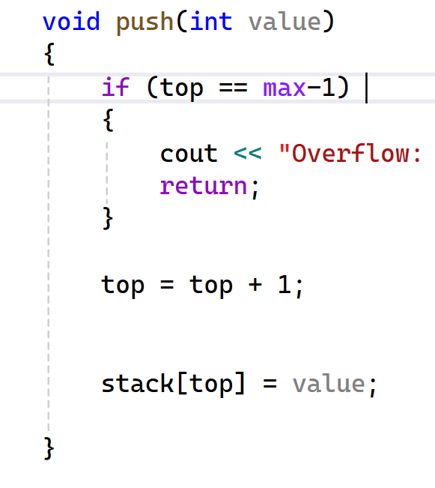
Stack
This is the Stack Overflow check. Since max is 5, max-1 is 4. The array indices are 0, 1, 2, 3, 4. If top is already at 4, the array is full.

Slide 6
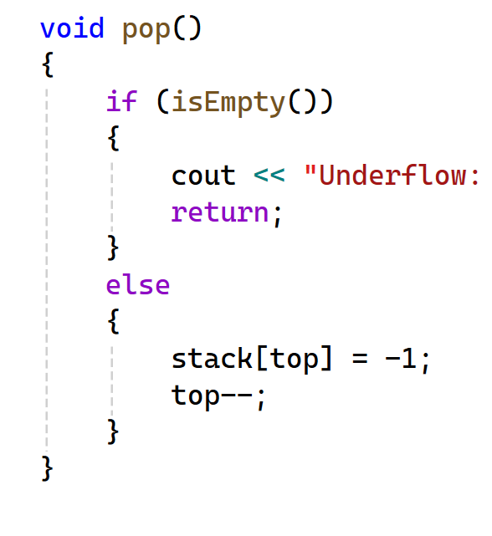
Stack
This is the Stack Underflow check. It calls isEmpty to see if there are any items to remove.
This is the actual "pop" operation. By simply decrementing the top index, the previous top element is no longer accessible and will be overwritten by the next push.

Slide 7
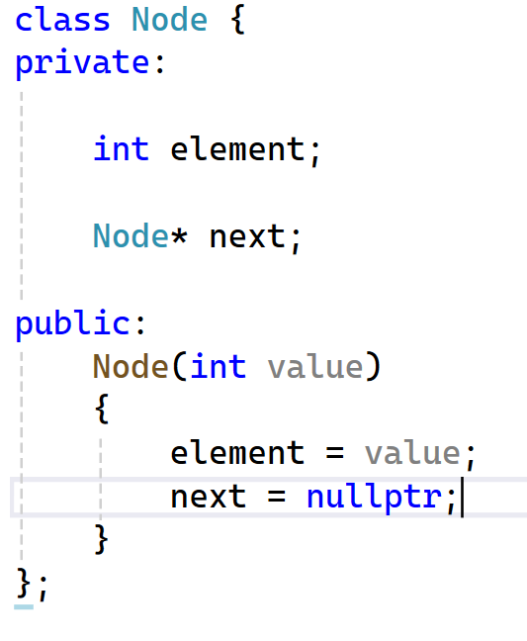
Stack (LL)
This is the variable that will hold the number (like 5, 10, 20) you want to store.
Pointer to the Next Node.
Constructor that initialize the members.

Slide 8
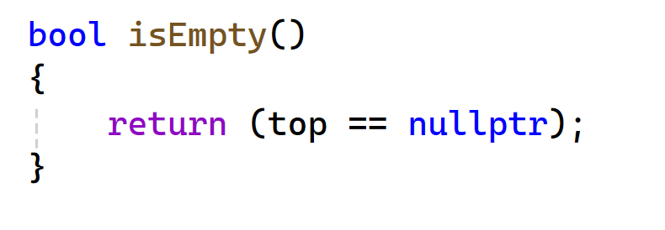
Stack (LL)
Stack is Empty or have data.

Slide 9
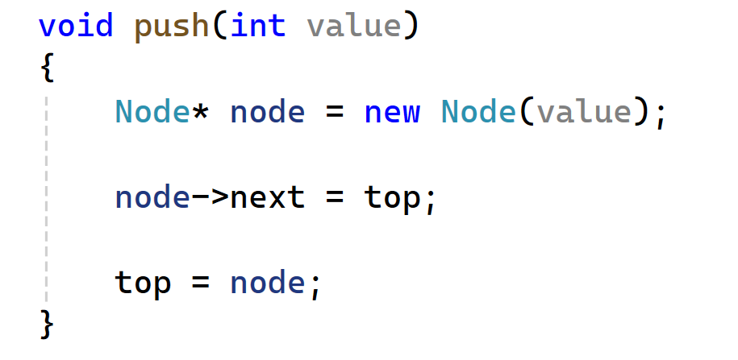
Stack (LL)
Create A New Node
We will assign top to the Next pointer of the newly created node. Initially when the node is empty the next will become nullptr;

Slide 10
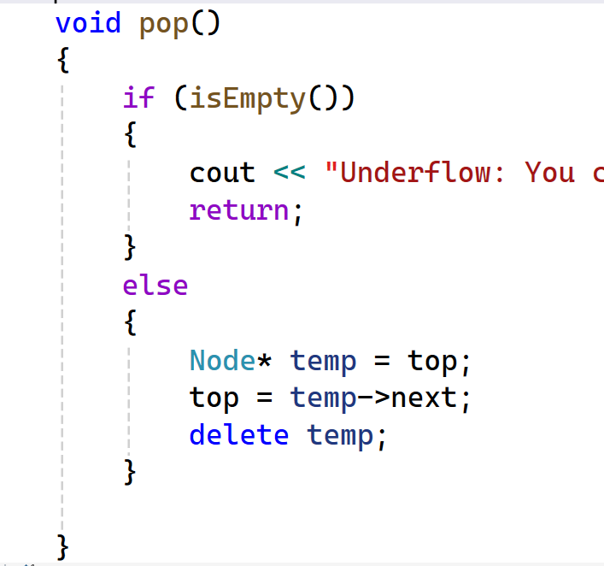
Stack (LL)
If the stack is empty nothing to remove.
Delete the node that is currently pointed by the top. And move the top to node next pointer

Slide 11

THANK YOU!

